Slide 1
Bayesian Network
Jinghao Zhao
12/04/2020

Slide 2
Bayesian Network
Representation
Model conditional dependency (causation)
Represent joint probability over a set of random variables
Inference
Typical Tasks
Conditional Probability Query P(X1,X2,...|E1,E2,...)
Marginalize one or a set variables P(X1, X2,...)

Slide 3
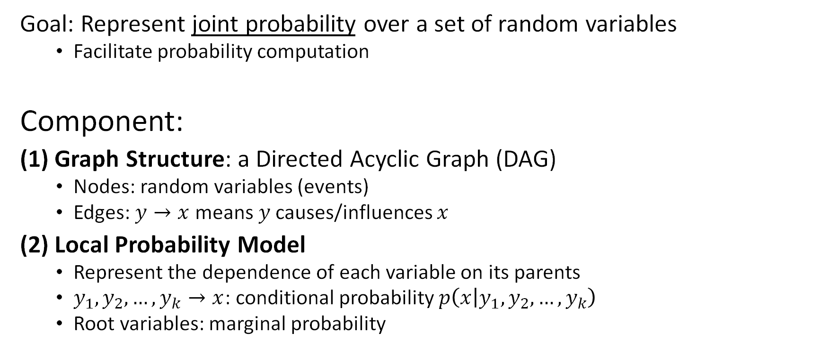
Bayesian Network
Goal: Represent joint probability over a set of random variables
Facilitate probability computation
Component:
(1) Graph Structure: a Directed Acyclic Graph (DAG)
Nodes: random variables (events)
Edges: $y→x$ means $y$ causes/influences $x$
(2) Local Probability Model
Represent the dependence of each variable on its parents
$y_{1},y_{2},…,y_{k}→x$: conditional probability $p\left(x | y_{1},y_{2},…,y_{k}\right)$
Root variables: marginal probability

Slide 4
Student Example – Graph Structure
A company wants to hire an intelligent student.
But intelligence cannot be directly measured.
But the company may have access to the student's SAT and GPA score.
Based on the observable evidence (SAT and GPA), company can try to infer whether this student is intelligent or not.
Notes:
A company wants to hire an intelligence student. But intelligence cannot be directly measured. But the company may have access to the student's SAT and GPA score. Based on the observable evidence, company can try to infer whether this student is intelligent or not.

Slide 5
Student Example – Graph Structure
Cannot be directly measured
Latent factor of its children
Intelligence
SAT
GPA
Can be directly observed
Notes:
A company wants to hire an intelligence student. But intelligence cannot be directly measured. But the company may have access to the student's SAT and GPA score. Based on the observable evidence, company can try to infer whether this student is intelligent or not.

Slide 6
Student Example – Graph Structure
Independent Random Variables
Intelligence
Overall Difficulty of Courses
GPA
P(GPA | Intelligence, Difficulty of Courses)
SAT
Notes:
In some cases, the observable event may depend on multiple latent factors.
For example, GPA may be influenced by both the student's intelligence and the course difficulty at the department of the school. Some school may give a harsh GPA while the average GPA in other schools may be higher. In this case, we introduce another random variable as a parent of GPA.
We condition GPA on Intelligence and overall difficulty of courses.
Root variables are independent of each other.

Slide 7
Student Example – A Full Bayesian Network
Component: (1) Graph Structure (DAG) (2) Local probability model (CPTs)
Conditional Probability Tabels
Intelligence
Overall Difficulty of Courses
Intelligence (I) | P(I)
True | 0.3
False | 0.7
Difficulty (D) | P(D)
Easy | 0.6
Hard | 0.4
SAT
GPA
I | SAT | P(SAT|I)
True | High | 0.7
True | Low | 0.3
False | High | 0.4
False | Low | 0.6
I | D | GPA | P(GPA|I,D)
True | Easy | High | 0.8
True | Easy | Low | 0.2
True | Hard | High | 0.6
... | ... | ... | ...
Notes:
An example of the full Bayesian network.
We can view the graph as encoding a generative sampling process executed by nature, where the value for each variable is selected by nature using a distribution that depends only on its parents. In other words, each variable is a stochastic function of its parents.

Slide 8

Topological Semantics
BN satisfies local Markov property:
A node is conditionally independent of its non-descendants given its parents.
Markovian Assumptions
Intelligence $⊥$ Difficulty
SAT $⊥$ GPA | Intelligence
SAT $⊥$ Difficulty | Intelligence
GPA $⊥$ SAT | Intelligence, Difficulty
Intelligence
Difficulty
SAT
GPA
A BN encodes a set of (conditional) independence assumptions (Markovian assumptions)
Notes:
A BN structure G encodes a set of conditional independence assumptions; every distribution for which G is an I-map must satisfy these assumptions.

Slide 9
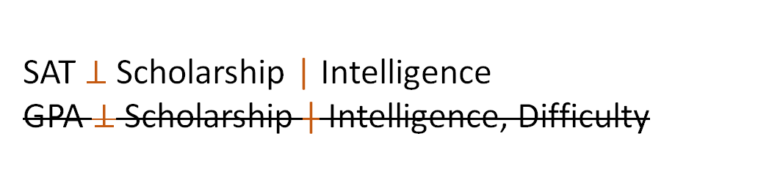
Topological Semantics
BN satisfies local Markov property:
A node is conditionally independent of its non-descendants given its parents.
Intelligence
Difficulty
SAT
GPA
SAT $⊥$ Scholarship | Intelligence
GPA $⊥$ Scholarship | Intelligence, Difficulty
Scholarship

Slide 10
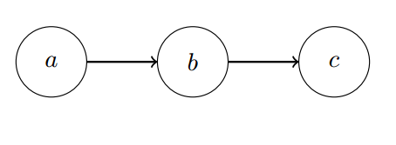
Exercise – conditional independency
Give the topological semantics encoded in the BN.
Notes:
c is independent of a given b
topological semantics mean the conditional independencies

Slide 11
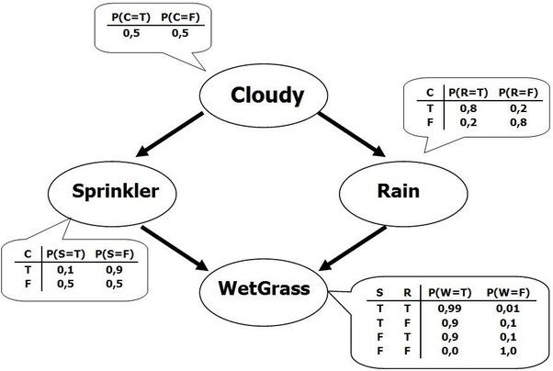
Exercise – conditional independency
Given Cloudy, what variables is Sprinkler conditional independent of?
Notes:
Now we know if Cloudy is true or false, the value of Sprinkler is independent of Rain

Slide 12
Exercise – conditional independency
Given Cloudy, what variables is Sprinkler conditional independent of?
Rain
Notes:
Now we know if Cloudy is true or false, the value of Sprinkler is independent of Rain

Slide 13

Joint Probability – Chain Rule for BN
The joint probability modeled by BN:
$P\left(X_{1}, X_{2},…,X_{N}\right)=\prod_{i=1}^{N}{P(X_{i}|parents of X_{i})}$，
Why?

Slide 14
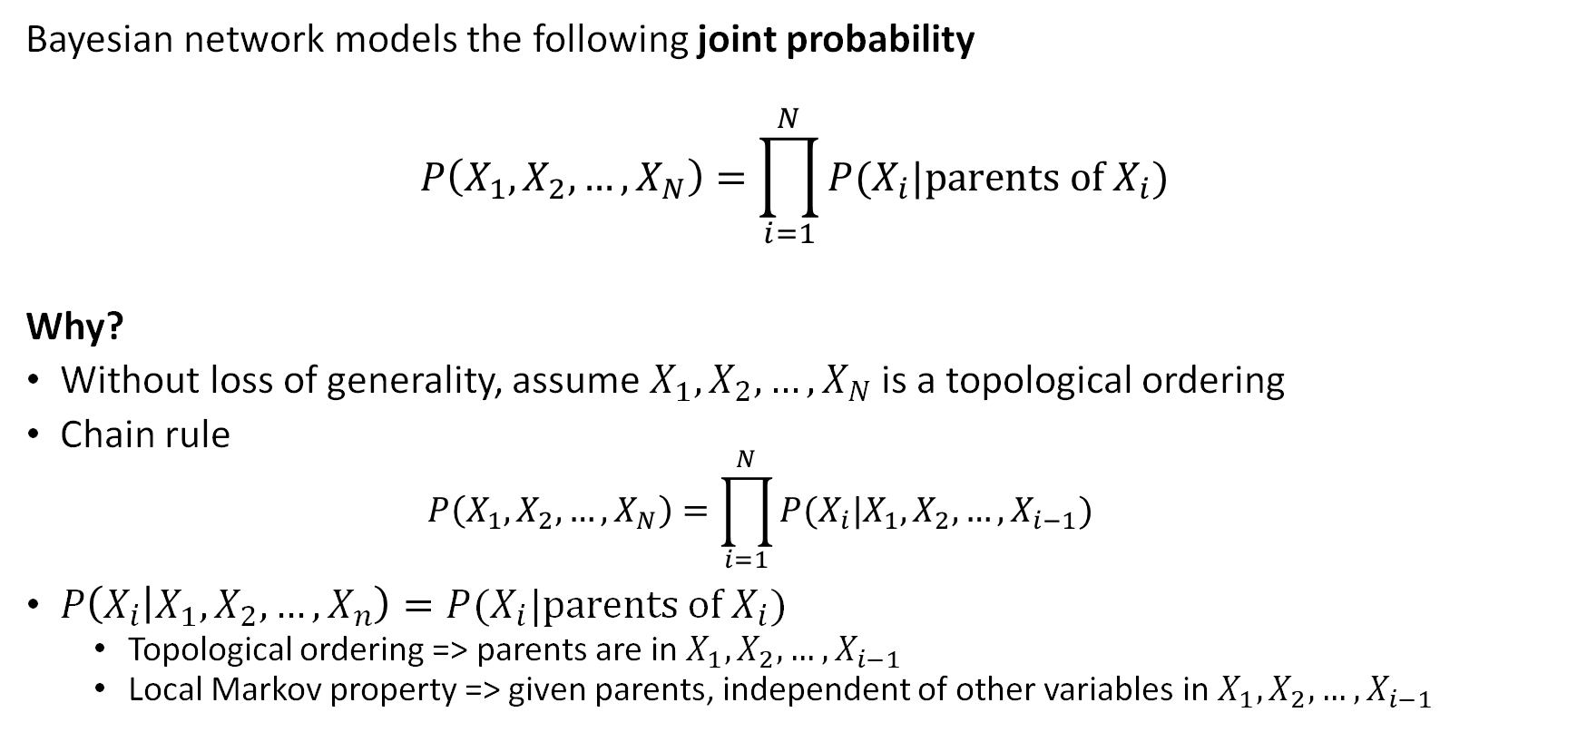
Joint Probability – Chain Rule for BN
Bayesian network models the following joint probability
$$P\left(X_{1}, X_{2},…,X_{N}\right)=\prod_{i=1}^{N}{P(X_{i}|parents of X_{i})}$$
Why?
Without loss of generality, assume $X_{1}, X_{2},…,X_{N}$ is a topological ordering
Chain rule
$$P\left(X_{1}, X_{2},…,X_{N}\right)=\prod_{i=1}^{N}{P(X_{i}|X_{1},X_{2},…,X_{i−1})}$$
$P\left(X_{i} | X_{1},X_{2},…,X_{n}\right)=P(X_{i}|parents of X_{i})$
Topological ordering => parents are in $X_{1},X_{2},…,X_{i−1}$
Local Markov property => given parents, independent of other variables in $X_{1},X_{2},…,X_{i−1}$

Slide 15
D-separation
A graphical criterion is used to identify independences (marginal or conditional) independences (marginal or conditional) that hold in the BN graph
Any complex example can be analyzed by considering relevant triples

Slide 16
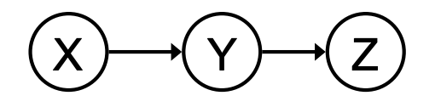
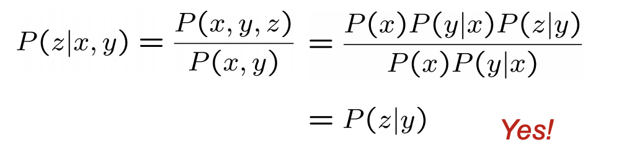
Causal Chains
“causal chain”
Is it guaranteed that X is independent of Z given Y?
Evidence along the chain “blocks” the influence

Slide 17
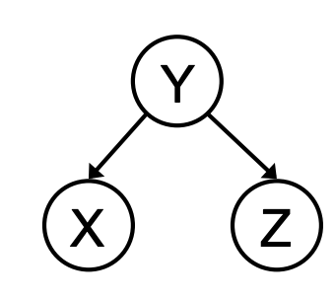
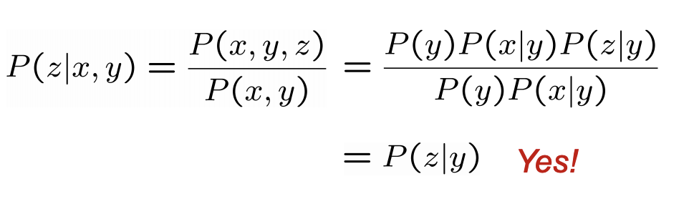
Common Cause
Two effects of the same cause
Is it guaranteed that X and Z are independent?
No!
Is it guaranteed that X and Z are independent given Y?
Observing the cause blocks influence between effects.

Slide 18
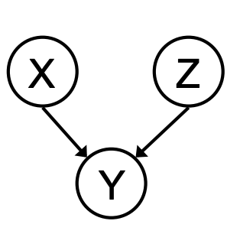
D-separation Examples
two causes of one effect (v-structures)
Are X and Z independent?
Yes!
Are X and Z independent given Y?
No!
Observing an effect activates influence between possible causes.

Slide 19
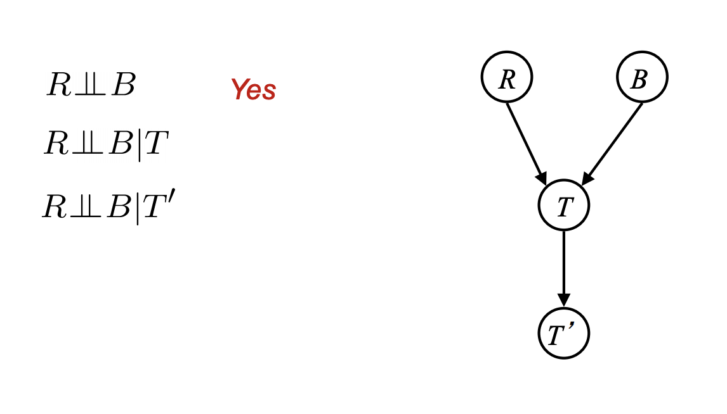
Example

Slide 20
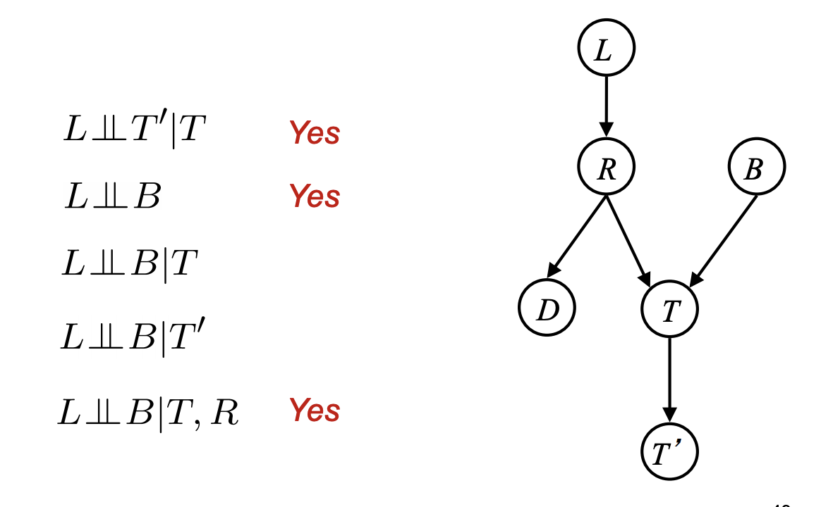
Example

Slide 21
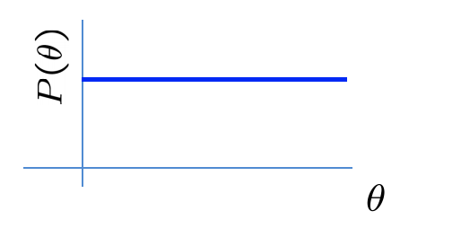
Prior distribution
What prior? What distribution do we want for a prior?
Represents expert knowledge (philosophical approach)
Simple posterior form (engineer’s approach)
For example, uninformative priors is a uniform distribution:

Slide 22
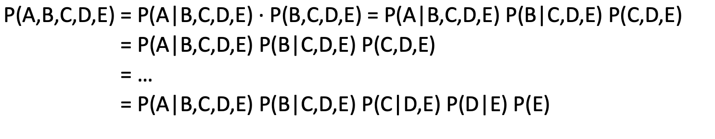
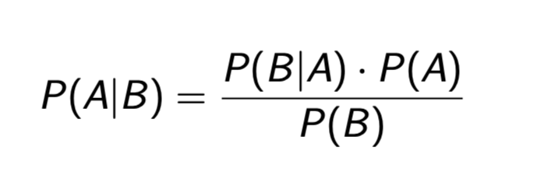
Chain Rule & Bayes Rule
Chain rule:
Bayes rule: important for reverse conditioning

Slide 23
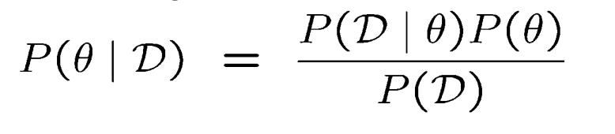
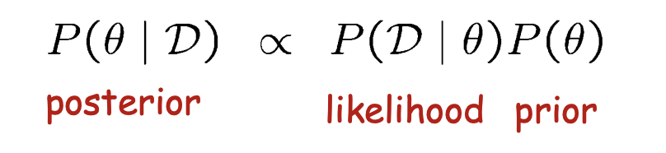
Bayesian Learning
Use Bayes rule:
Or equivalently:

Slide 24
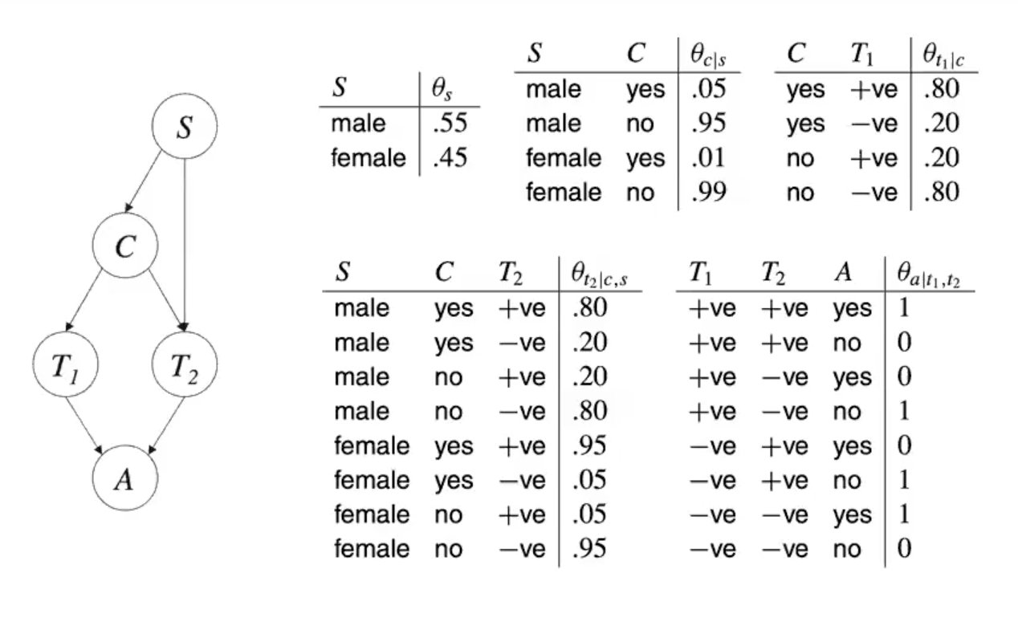
Most probable explanation (MPE)
Most probable explanation (MPE), also known as max propagation, computes the most probable configuration of variables that do not have evidence.
The MPE given the evidence A=yes:
C=no
S=female
T1=-ve
T2=-ve

Slide 25
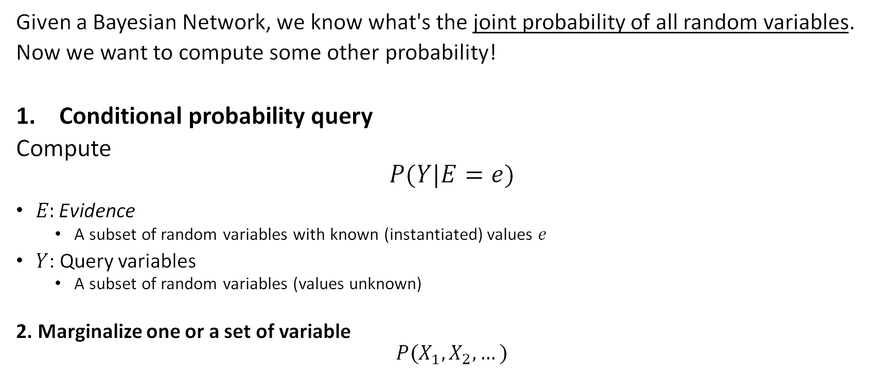
Task: Probability Query
Given a Bayesian Network, we know what's the joint probability of all random variables.
Now we want to compute some other probability!
Conditional probability query
Compute
$$P(Y|E=e)$$
$E:\text{Evidence}$
A subset of random variables with known (instantiated) values $e$
$Y$: Query variables
A subset of random variables (values unknown)
2. Marginalize one or a set of variable
$$P(X_{1},X_{2}, …)$$
Notes:
The problem of inference in graphical models is NP-hard. The exponential blowup is unavoidable.
Approximate inference is also NP-hard .
In general, we don’t care about the worst case, but about the cases that we encounter in practice.
Many real-world applications can be tackled very effectively using exact or approximate inference algorithms for graphical models.

Slide 26
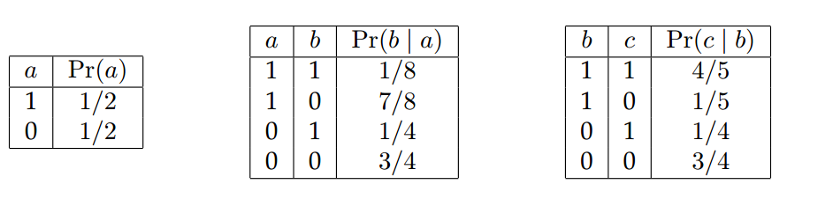
Example – Inference
compute Pr(a=T|b=T)

Slide 27
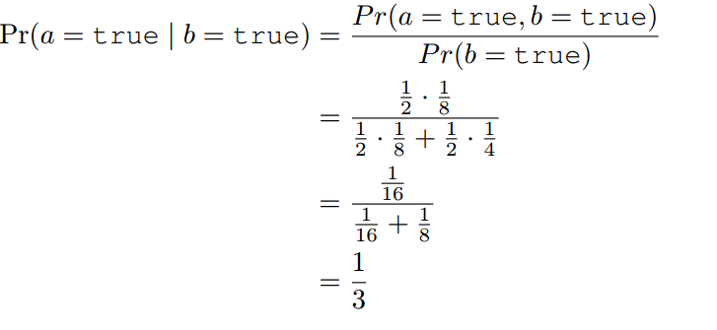
Example – Inference

Slide 28
Variable Elimination
Dynamic Programming
Sum out one variable at a time
Basic computation step: manipulation of factors
Cache intermediate results to improve efficiency
Let's start from a simple example and move to complex ones.

Slide 29

Example - Try to Compute Some Probability
A
B
C
D
Goal: Compute $P\left(D\right)$
Seems very easy!

Slide 30

Example - Try to Compute Some Probability
$$P\left(D\right)=\sum_{C}{\sum_{B}{\sum_{A}{P(A,B,C,D)}}}$$
$$P\left(D\right)=P\left(D | c\right)P\left(c\right)+P\left(D | \overline{c}\right)P\left(\overline{c}\right) \\ =\sum_{C}{P\left(D | C\right)P(C)}$$
$$=\sum_{C}{P\left(D | C\right)\sum_{B}{P\left(C | B\right)P(B)}}$$
$$=\sum_{C}{P\left(D | C\right)\sum_{B}{P\left(C | B\right)\sum_{A}{P\left(B | A\right)P(A)}}}$$
$$=\sum_{C}{\sum_{B}{\sum_{A}{P(A,B,C,D)}}}$$
A
B
C
D
C=True
C=False
written as
similarly

Slide 31
Example - Try to Compute Some Probability
$$P\left(D\right)=\sum_{C}{\sum_{B}{\sum_{A}{P(A,B,C,D)}}}$$
$$P\left(D\right)=P\left(D | c\right)P\left(c\right)+P\left(D | \overline{c}\right)P\left(\overline{c}\right) \\ =\sum_{C}{P\left(D | C\right)P(C)}$$
$$=\sum_{C}{P\left(D | C\right)\sum_{B}{P\left(C | B\right)P(B)}}$$
$$=\sum_{C}{P\left(D | C\right)\sum_{B}{P\left(C | B\right)\sum_{A}{P\left(B | A\right)P(A)}}}$$
$$=\sum_{C}{\sum_{B}{\sum_{A}{P(A,B,C,D)}}}$$
A
B
C
D

Slide 32

Example - Try to Compute Some Probability
A
B
C
D
Goal: Compute $P\left(D\right)$
$$P\left(D\right)=\sum_{C}{\sum_{B}{\sum_{A}{P(A,B,C,D)}}}$$
Sum out extra variables

Slide 33

Example - Try to Compute Some Probability
A
B
C
D
What if we want to compute $P\left(C\right)?$ Does this equation hold?
$$P\left(C\right)=\sum_{D}{\sum_{B}{\sum_{A}{P(A,B,C,D)}}}$$

Slide 34
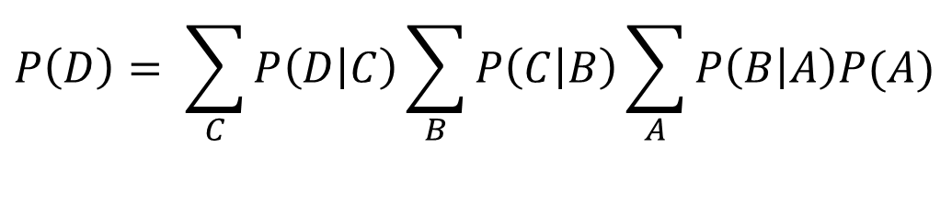
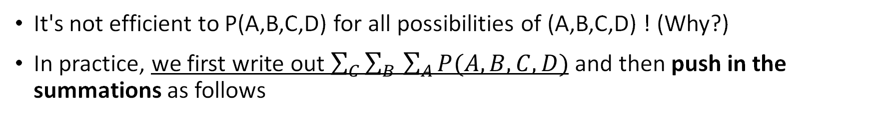
Variable Elimination
A
B
C
D
It's not efficient to P(A,B,C,D) for all possibilities of (A,B,C,D) ! (Why?)
In practice, we first write out $\sum_{C}{\sum_{B}{\sum_{A}{P(A,B,C,D)}}}$ and then push in the summations as follows
$$P\left(D\right)= \sum_{C}{P\left(D | C\right)\sum_{B}{P\left(C | B\right)\sum_{A}{P\left(B | A\right)P(A)}}}$$
How to efficiently compute it???
Notes:
ph_1(A): P(A)
ph_2(A,B): P(B|A)

Slide 35
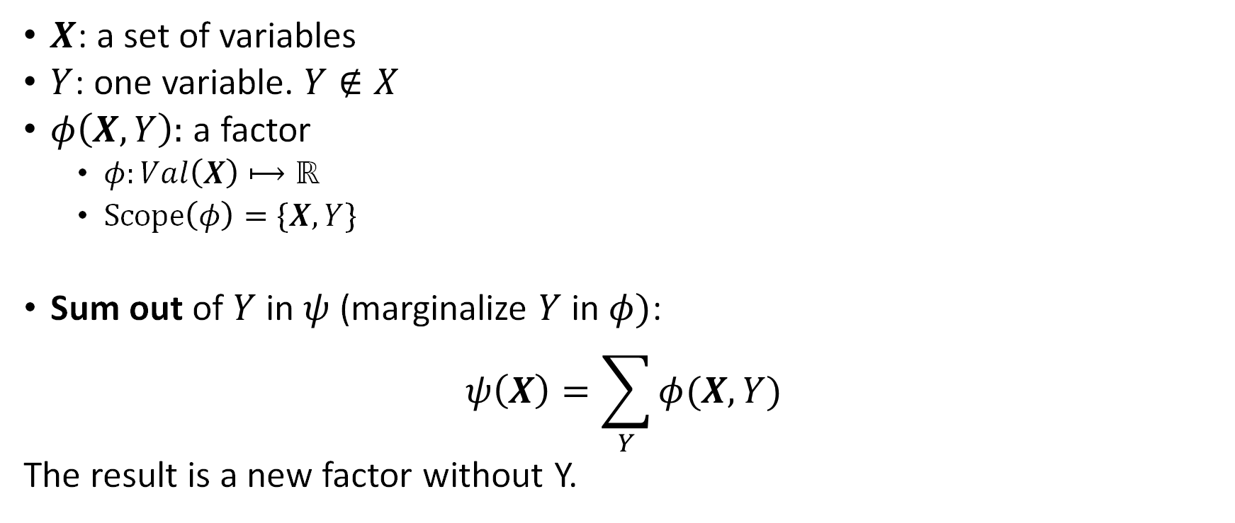
Summing Out a Variable (Factor Marginalization)
$X$: a set of variables
$Y$: one variable. $Y∉X$
$φ\left(X, Y\right):$ a factor
$φ:Val\left(X\right)⟼ℝ$
$Scope\left(φ\right)=\{X, Y\}$
Sum out of $Y$ in $ψ$ (marginalize $Y$ in $φ)$:
$$ψ\left(X\right)=\sum_{Y}{φ(X,Y)}$$
The result is a new factor without Y.

Slide 36
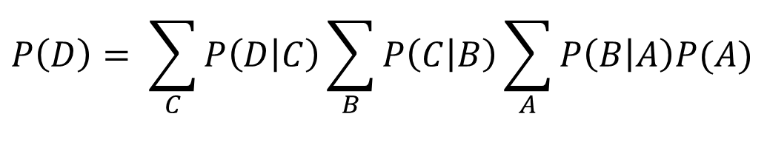
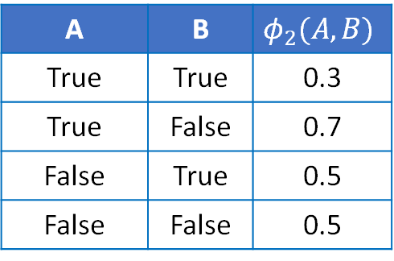

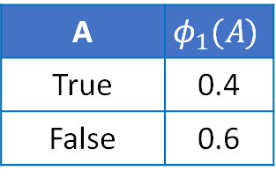

Factors
A
B
C
D
$$P\left(D\right)= \sum_{C}{P\left(D | C\right)\sum_{B}{P\left(C | B\right)\sum_{A}{P\left(B | A\right)P(A)}}}$$
$$φ_{2}(A,B)$$
$$φ_{1}(A)$$
A | $$φ_{1}(A)$$
True | 0.4
False | 0.6
A | B | $$φ_{2}(A,B)$$
True | True | 0.3
True | False | 0.7
False | True | 0.5
False | False | 0.5
Notes:
ph_1(A): P(A)
ph_2(A,B): P(B|A)

Slide 37
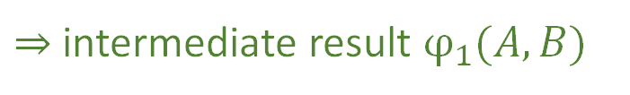
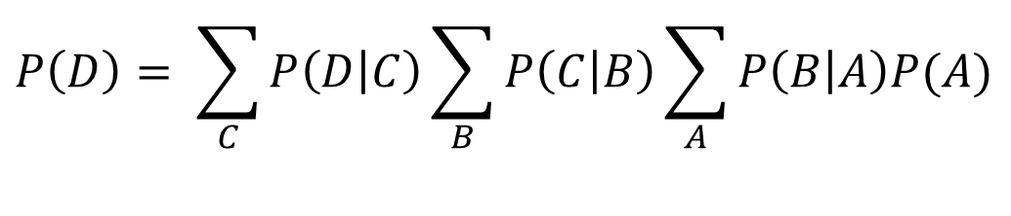
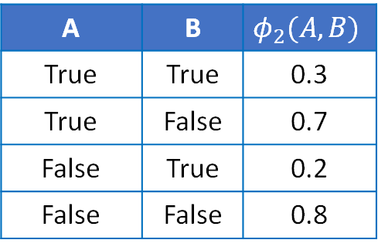
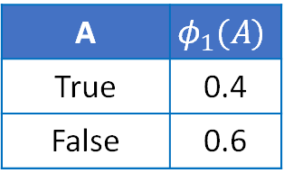

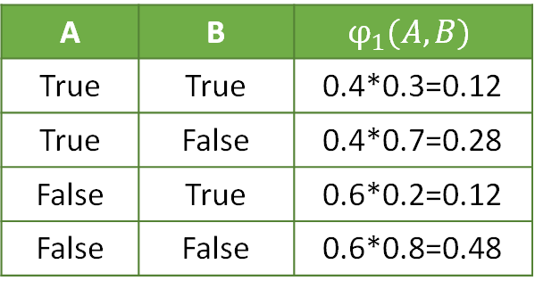
Factor Multiplication
A
B
C
D
A | $$φ_{1}(A)$$
True | 0.4
False | 0.6
$$P\left(D\right)= \sum_{C}{P\left(D | C\right)\sum_{B}{P\left(C | B\right)\sum_{A}{P\left(B | A\right)P(A)}}}$$
$$φ_{2}(A,B)$$
$$φ_{1}(A)$$
A | B | $$φ_{2}(A,B)$$
True | True | 0.3
True | False | 0.7
False | True | 0.2
False | False | 0.8
Factor Multiplication
$⇒$ intermediate result $φ_{1}(A,B)$
A | B | $$φ_{1}(A,B)$$
True | True | 0.4*0.3=0.12
True | False | 0.4*0.7=0.28
False | True | 0.6*0.2=0.12
False | False | 0.6*0.8=0.48
Notes:
ph_1(A): P(A)
ph_2(A,B): P(B|A)

Slide 38

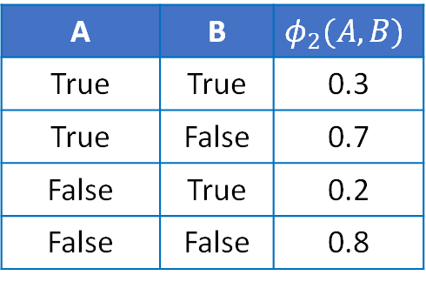

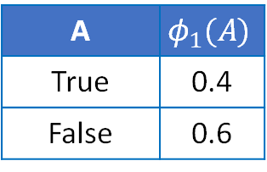
Summing Out a Variable
A
B
C
D
$$P\left(D\right)= \sum_{C}{P\left(D | C\right)\sum_{B}{P\left(C | B\right)\sum_{A}{P\left(B | A\right)P(A)}}}$$
A | $$φ_{1}(A)$$
True | 0.4
False | 0.6
$$φ_{1}(A,B)$$
A | B | $$φ_{2}(A,B)$$
True | True | 0.3
True | False | 0.7
False | True | 0.2
False | False | 0.8
$$⇒ ψ_{1}(B)$$
Notes:
ph_1(A): P(A)
ph_2(A,B): P(B|A)

Slide 39
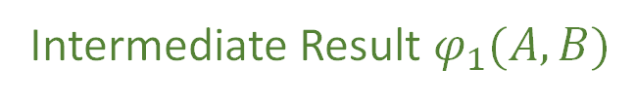
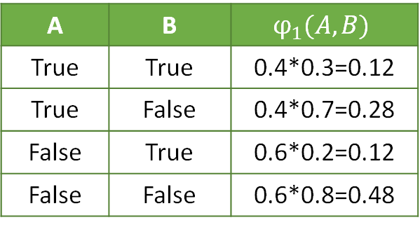
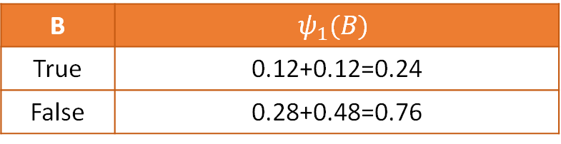
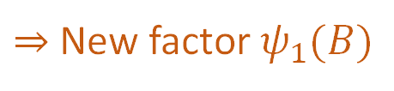
Summing Out a Variable
A
B
C
D
Intermediate Result $φ_{1}(A,B)$
Summing out A
A | B | $$φ_{1}(A,B)$$
True | True | 0.4*0.3=0.12
True | False | 0.4*0.7=0.28
False | True | 0.6*0.2=0.12
False | False | 0.6*0.8=0.48
$$P\left(D\right)= \sum_{C}{P\left(D | C\right)\sum_{B}{P\left(C | B\right)\sum_{A}{P\left(B | A\right)P(A)}}}$$
$$φ_{1}(A,B)$$
$⇒$New factor $ψ_{1}(B)$
B | $$ψ_{1}(B)$$
True | 0.12+0.12=0.24
False | 0.28+0.48=0.76
new factor without A
Notes:
ph_1(A): P(A)
ph_2(A,B): P(B|A)

Slide 40





Variable Elimination
A
B
C
D
$$P\left(D\right)= \sum_{C}{P\left(D | C\right)\sum_{B}{P\left(C | B\right)\sum_{A}{P\left(B | A\right)P(A)}}}$$
$$φ_{4}(C,D)$$
$$φ_{3}(B,C)$$
$$φ_{2}(A,B)$$
$$φ_{1}(A)$$
$${⇒ ψ_{1}(B)}_{}$$
$${⇒ψ}_{2}(C)$$
$${⇒ψ}_{3}(D)$$
Result!
Notes:
ph_1(A): P(A)
ph_2(A,B): P(B|A)

